Slide 1
More on Deep Learning in NLP

Slide 2
Recursive Neural Networks
The RNN (Recurrent Neural networks) is very useful for modeling sequences.
In language processing, it is often natural and desirable to work with tree structures.
The trees can be syntactic trees, discourse trees, or even trees representing the sentiment expressed by various parts of a sentence.
We may want to predict values based on specific tree nodes, predict values based on the root nodes, or assign a quality score to a complete tree or part of a tree.
In other cases, we may not care about the tree structure directly but rather reason about spans in the sentence. In such cases, the tree is merely used as a backbone structure which helps guide the encoding process of the sequence into a fixed size vector.
The main intuition behind the recursive neural networks is that each subtree is represented as a d dimensional vector, and the representation of a node p with children c1 and c2 is a function of the representation of the nodes: vec(p) = f(vec(c1),vec(c2)), where f is a composition function taking two d-dimensional vectors and returning a single d-dimensional vector.

Slide 3
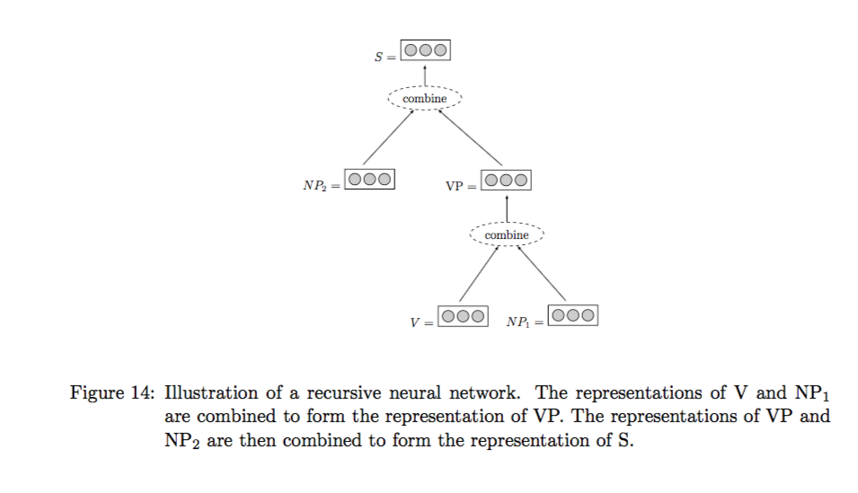

Slide 4
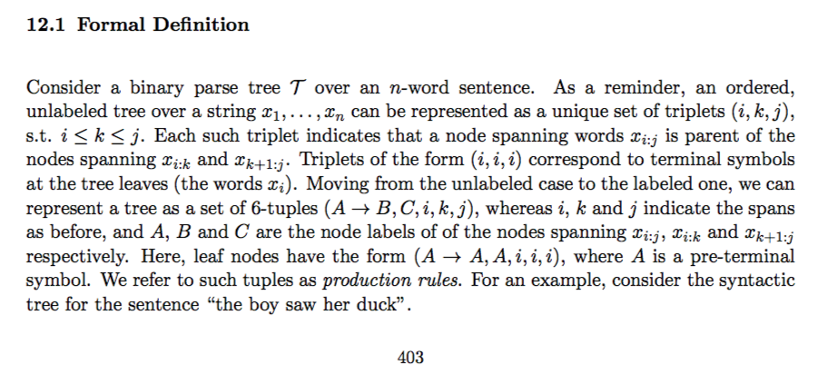

Slide 5
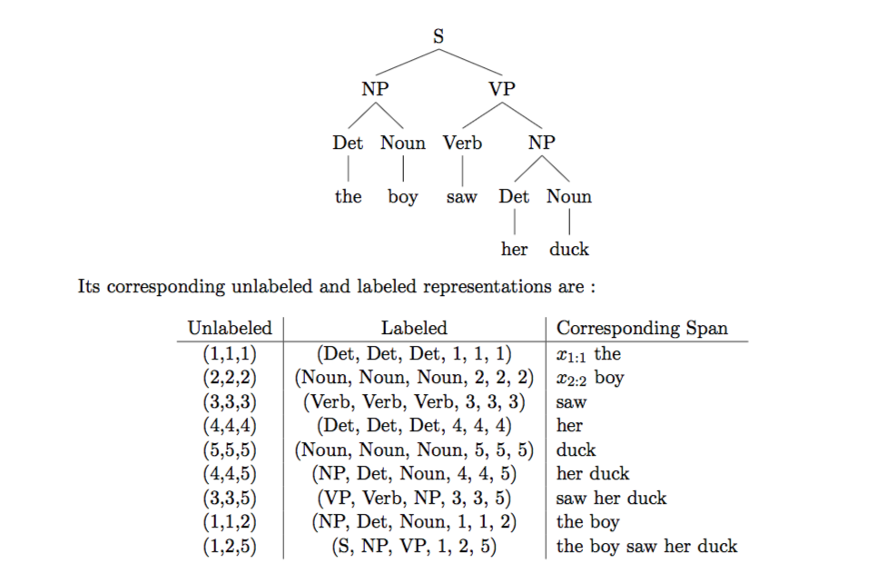

Slide 6
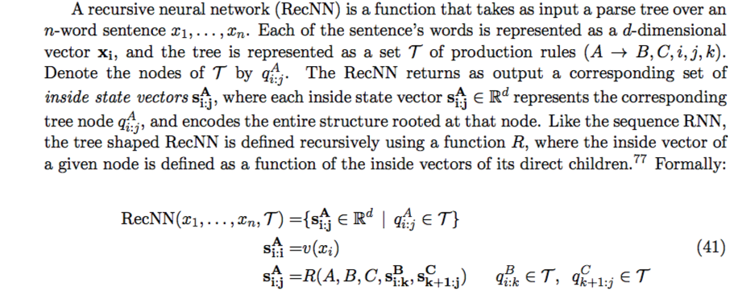

Slide 7
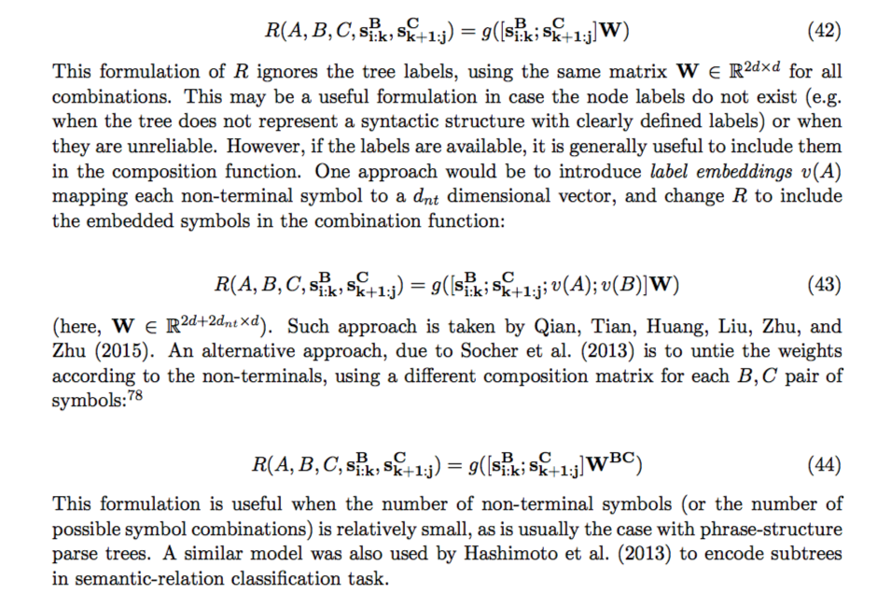

Slide 8
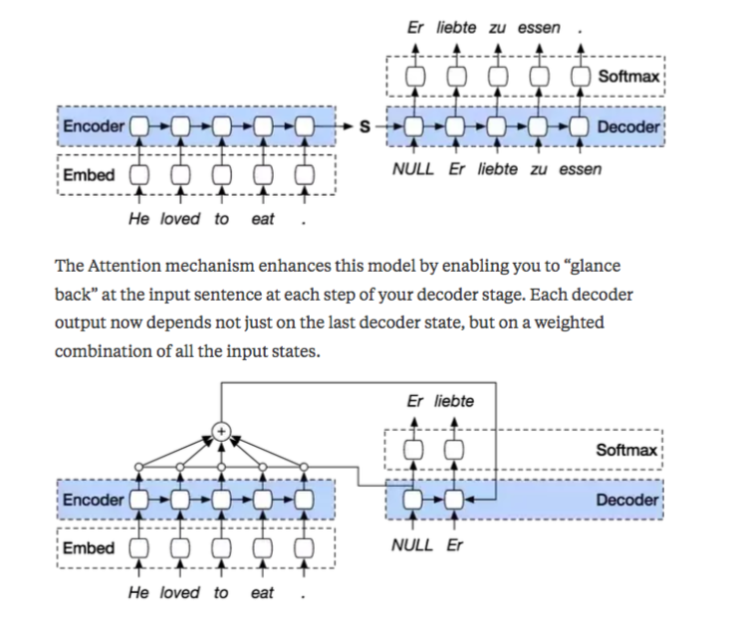
Attention Mechanism
Notes:
Attention: Weighted sum

